Slide 1
 | Present | Past | Future
Simple Indefinite | They clean the room every week. She cleans the room every day. . | They cleaned the room yesterday. She cleaned the room yesterday. | They will clean the room next week. She will clean the room next week.
Continuous to be + PI (V-ing) | She is cleaning the room now. | When I came she was cleaning the room. | Tomorrow from 11 till 12 she will be cleaning the room.
Perfect to have + PII (V-ed/ III ф.) | She has already cleaned the room. | When I came she had already cleaned the room. | She will have cleaned the room by 2 o’clock.
Perfect Continuous to have been + PI | She has been cleaning the room all the morning. | When I came she had been cleaning the room for two hours. | When I phone her in 20 minutes she will have been cleaning the room for two hours.

Slide 2
Past Continuous
действие совершалось в какой-то момент (период) времени;
подчеркивается незавершенный, длительный (длящийся) или временный характер действия в прошлом;
два соотнесенных (одновременных, но разной продолжительности) действия
When I came/she saw…, yesterday at 3 o’clock,
from … till … o’clock, at that moment,
all day yesterday, all the time, the whole evening…

Slide 3
Past Continuous
When I came she was cleaning the room.
When I came they were not cleaning the room.
Was she cleaning the room when you came?
Yes, she was. No, she wasn’t.

Slide 4
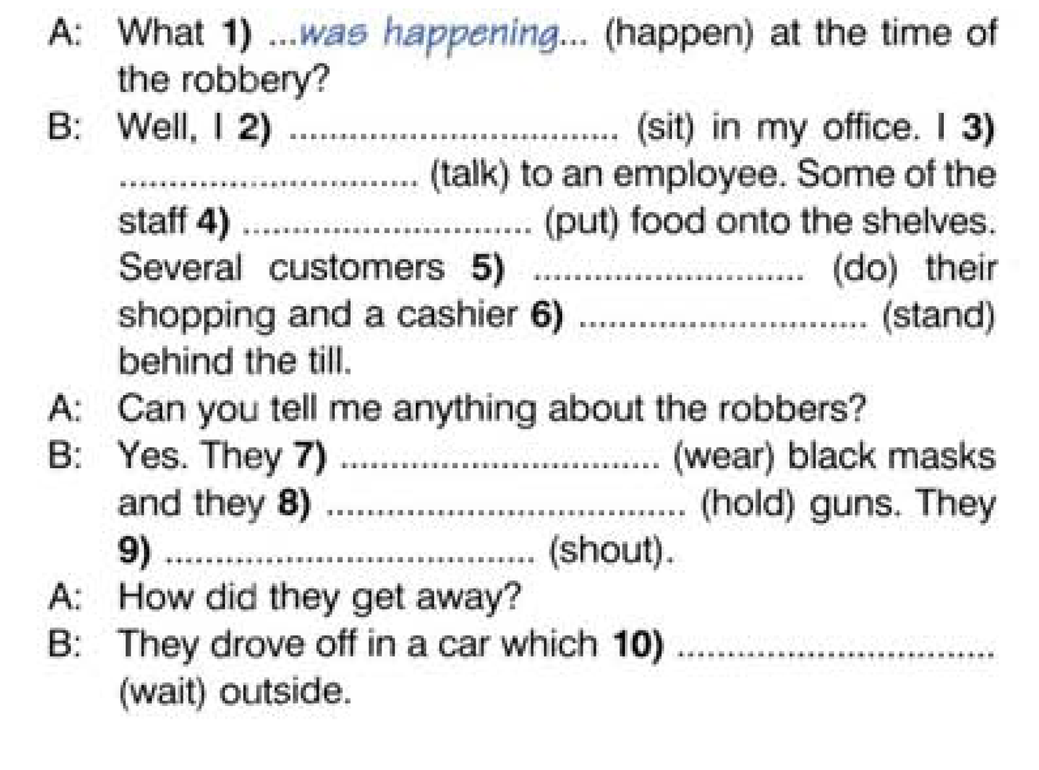

Slide 5
Past Perfect
предпрошедшее
подчеркивает действие, которое произошло, завершилось ранее другого действия или момента в прошлом
When I came …by Saturday, by the end of the year, before, after, …

Slide 6
Past Perfect
When I came she had already cleaned the room.
When I came she hadn’t cleaned the room yet.
Had she cleaned the room when you came?
Yes, she had. No, she hadn’t.

Slide 7
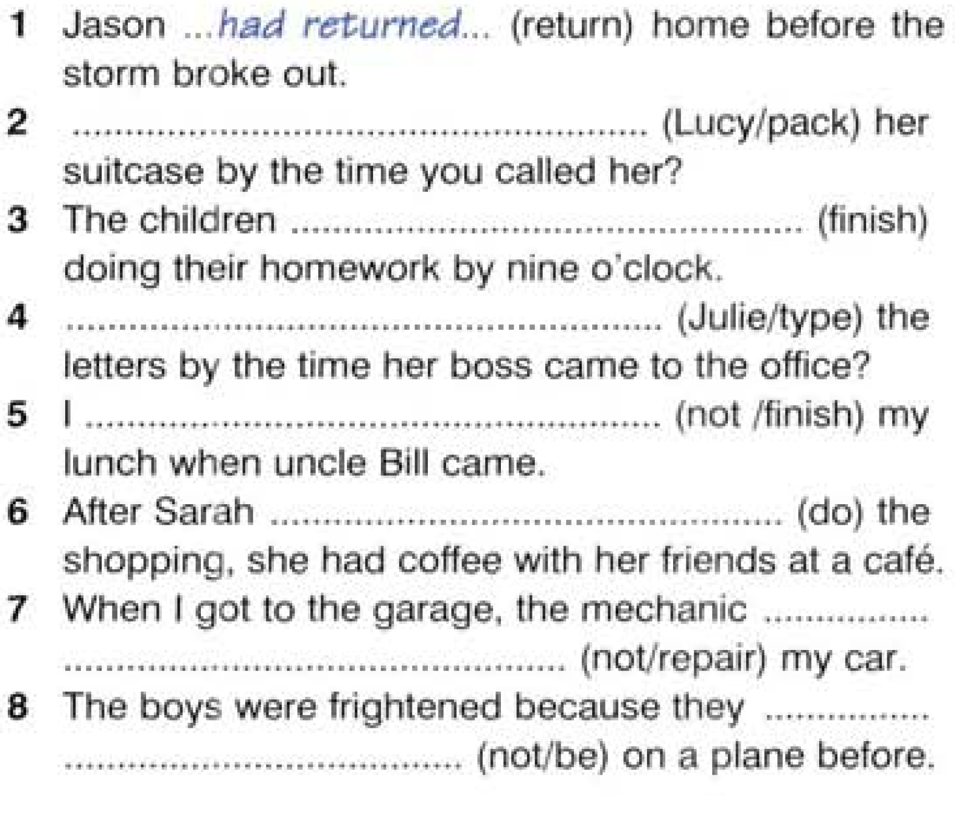

Slide 8
